Slide 1
Hardware
hacking
Leon Bonde Larsen et al.

Slide 2
Hardware
Agenda:
Devices for hacking
Hacking devices
Hardware exploits

Slide 3

Attack surfaces of a computer
Network
Software
Physical

Slide 4
Hardware for hacking
Virtual user devices
Network devices
RF devices
Special purpose devices

Slide 5
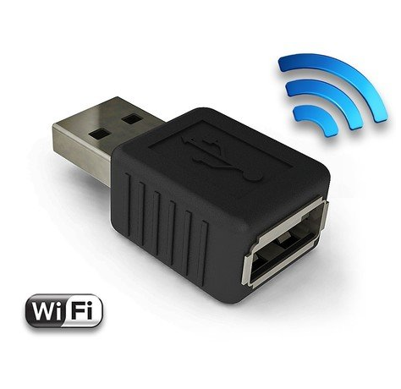
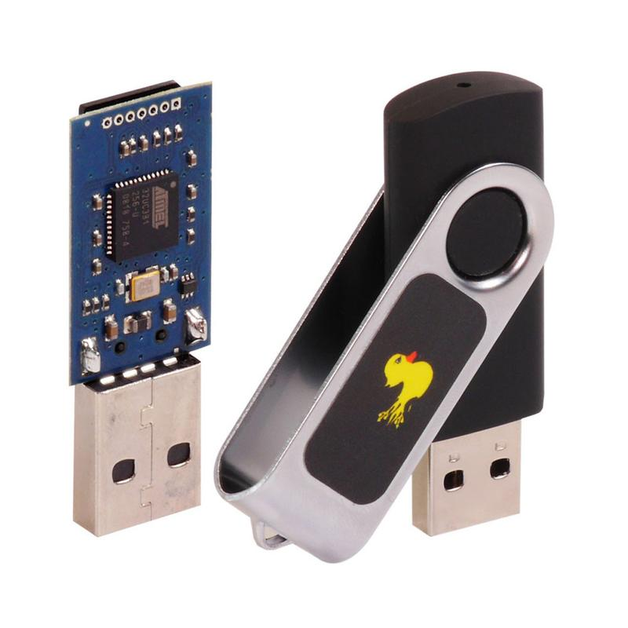
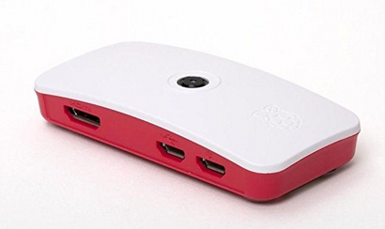
Virtual user devices
AirDrive
Rubber Ducky
Pi zero

Slide 6
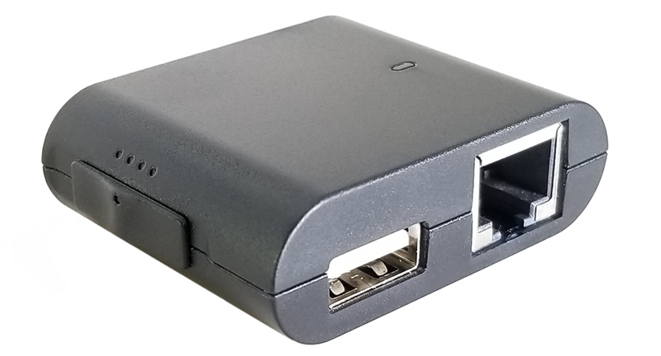
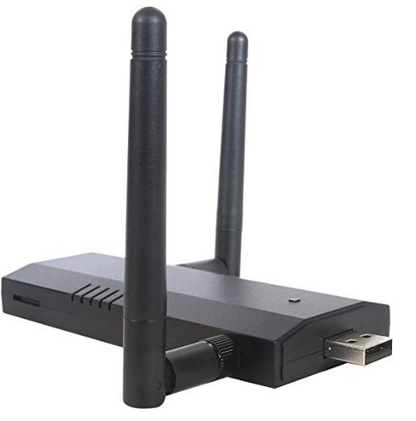
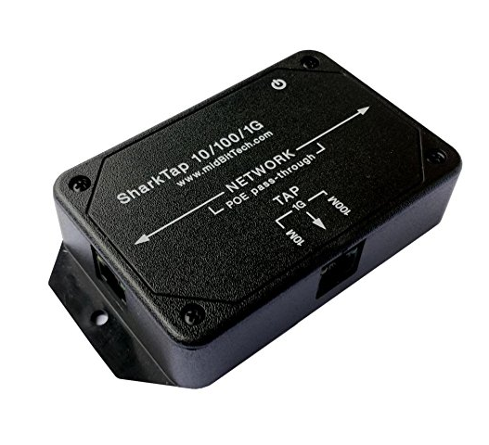
Network devices
Packet Squirrel
Pineapple
SharkTap

Slide 7
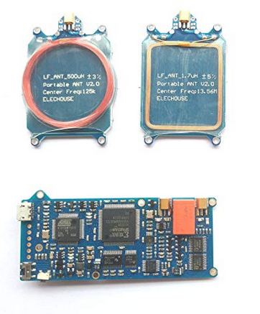
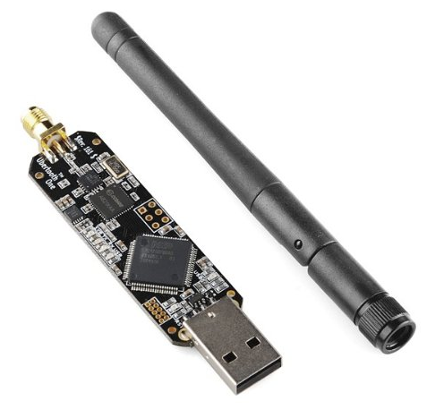
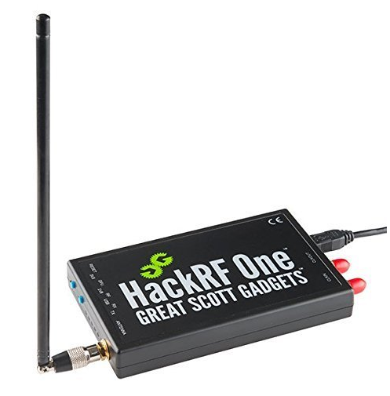
RF devices
Proxmark
UberTooth
HackRF

Slide 8
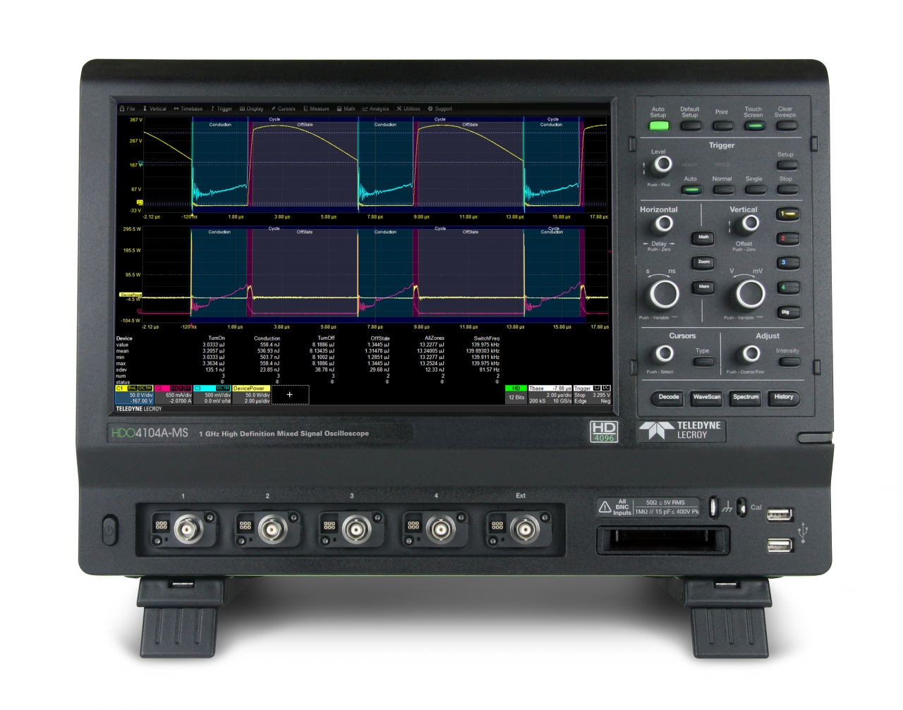
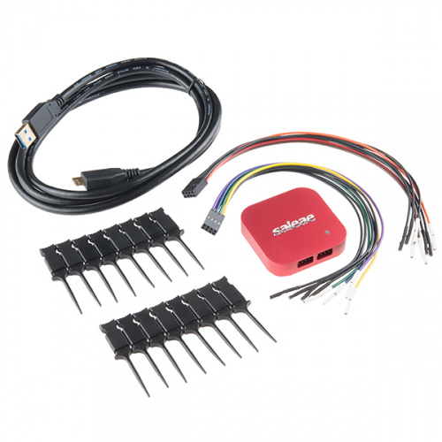
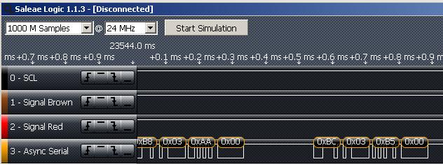
General purpose

Slide 9
Special purpose
Desoldering equipment
JTAG interfaces
Chip opening

Slide 10
Side-channel attacks

Slide 11
Simple password
for ( i = 0 ; i < MAX_LENGTH ; i++ ) {
if ( pass[i] == '\0' ) { printf("Password correct\n"); break; } if ( pass[i] != true_pass[i] ) { printf("Password incorrect!!!\n"); break; } }

Slide 12
Simple password
D
E
L
T
A
\n

Slide 13
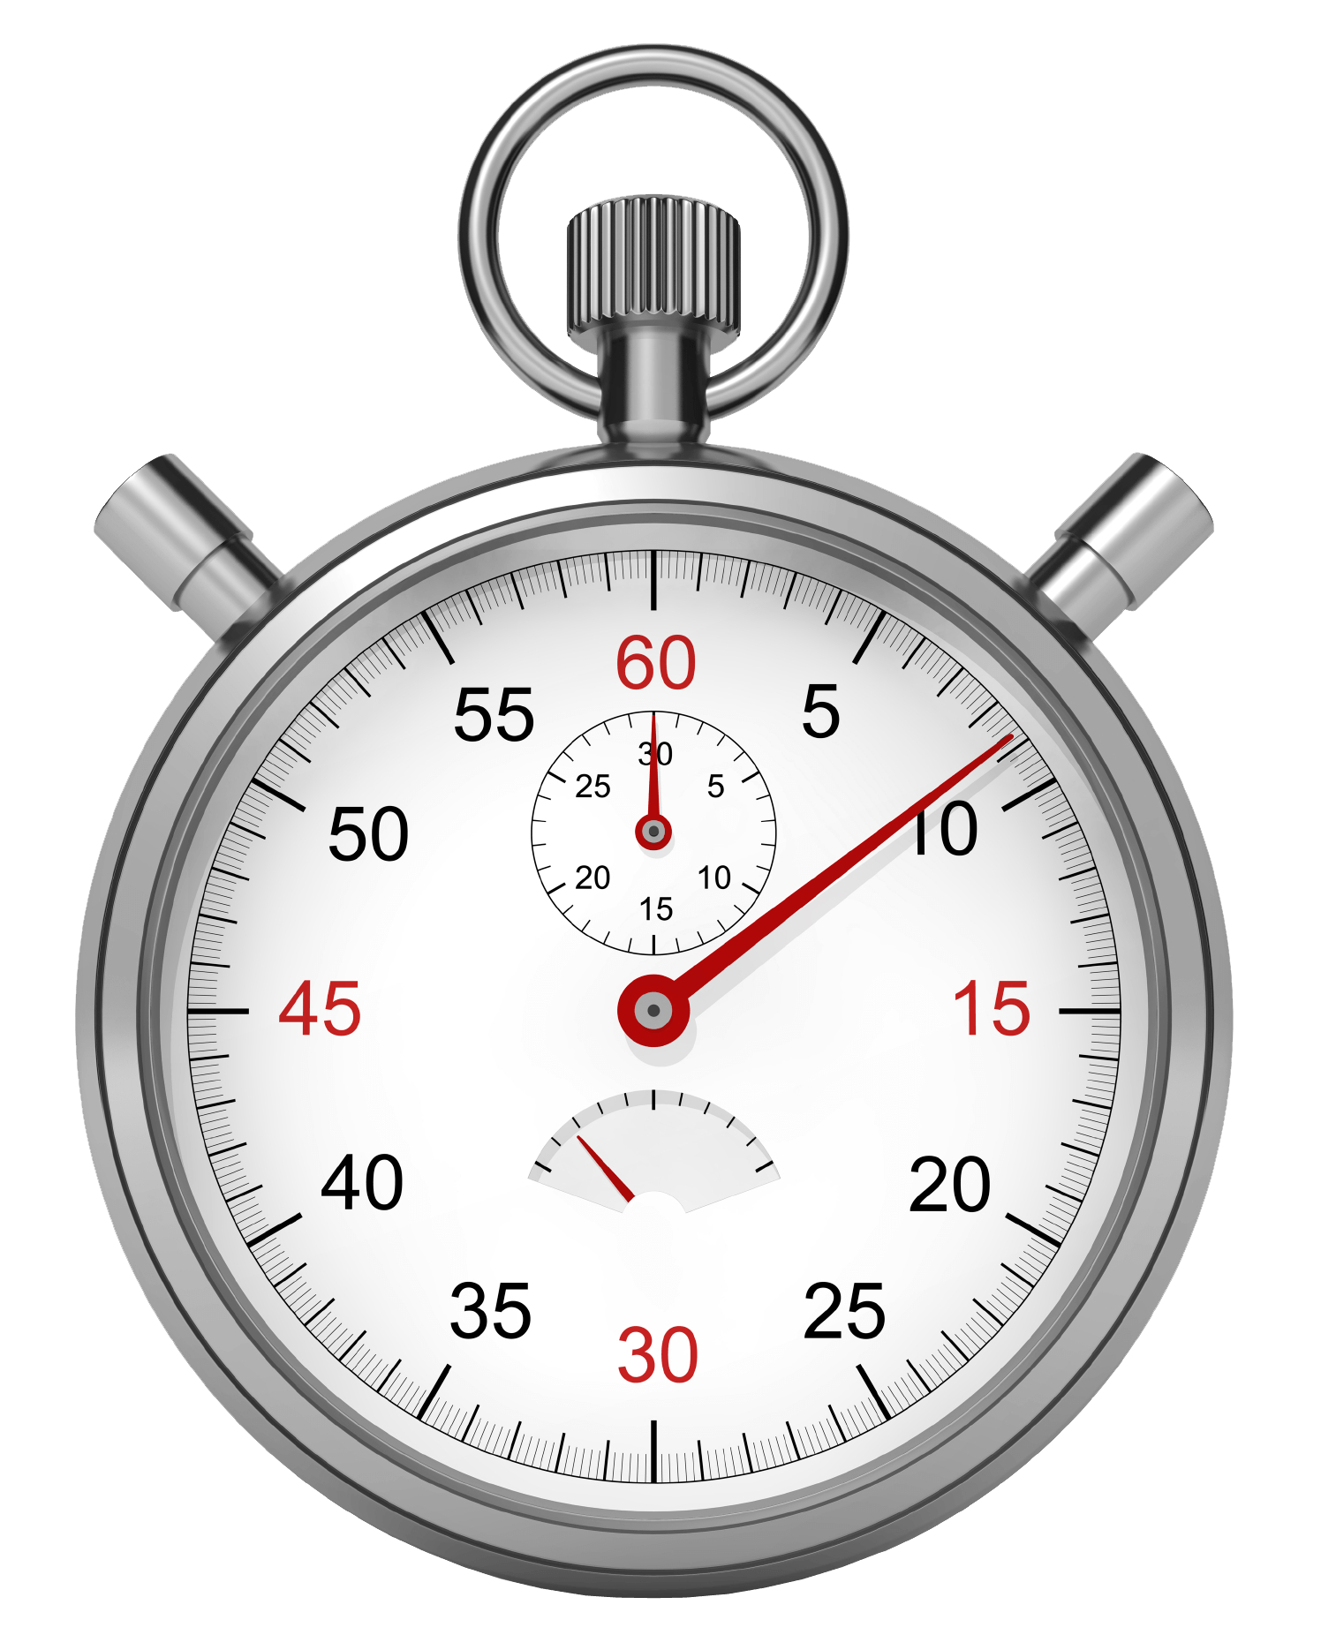
Simple password
D
E
L
T
A
\n

Slide 14
Simple password
“A” ?
D
E
L
T
A
\n

Slide 15
Simple password
“A” ?
no
D
E
L
T
A
\n

Slide 16
Simple password
“A” ?
no
0.001 s
D
E
L
T
A
\n

Slide 17
Simple password
“A” ?
no
0.001 s
“B” ?
no
D
E
L
T
A
\n

Slide 18
Simple password
“A” ?
no
0.001 s
“B” ?
no
0.001 s
D
E
L
T
A
\n

Slide 19
Simple password
“A” ?
no
0.001 s
“B” ?
no
0.001 s
D
E
L
T
A
\n
“C” ?
no
0.001 s

Slide 20
Simple password
“A” ?
no
0.001 s
“B” ?
no
0.001 s
D
E
L
T
A
\n
“C” ?
no
0.001 s
“D” ?
no
0.002 s

Slide 21
Simple password
“A” ?
no
0.001 s
“B” ?
no
0.001 s
D
E
L
T
A
\n
“C” ?
no
0.001 s
“D” ?
no
0.002 s
“DA”?

Slide 22
Simple password
“A” ?
no
0.001 s
“B” ?
no
0.001 s
D
E
L
T
A
\n
“C” ?
no
0.001 s
“D” ?
no
0.002 s
“DA”?
no

Slide 23
Simple password
“A” ?
no
0.001 s
“B” ?
no
0.001 s
D
E
L
T
A
\n
“C” ?
no
0.001 s
“D” ?
no
0.002 s
“DA”?
no
0.002 s

Slide 24
Excercise
You have accidentally *cough* come by a pcap file (traffic.pcapng.gz) with data from a target browsing his facebook. You also have a keyring program that outputs the master key used for the traffic, given the right password (get_key).
The goal of this 3-step exercise is to hack the poor guys facebook account and write a greeting on his wall, proving that you succeeded.

Slide 25
Excercise
You have found a python script, in some dark corner of the internet, that can time how long it takes to make a password attempt (time_pw_attempt.py).
1. Modify the time_pw_attempt.py program and try to break the password using time as a side channel.

Slide 26
Discussion
How was that?
Did you get the password?
Any thoughts on side-channel attacks?
Was there a clear timing difference?
A little cheating…
We will get back to side-channels next time

Slide 27
Hacking hardware

Slide 28
Why would we hack hardware?
Gain access to extra functionality
Modify the hardware
Gain access to proprietary IP
Compromise a device or device type
Gain access to secret data on a device
...

Slide 29
Opportunistic approach
Is there a UART?
Is there an SD card?
Is there eMMC memory?
…
https://www.exploitee.rs/

Slide 30
Disassembly and decompilation
Secrets can be revealed
IP can be stolen
Code can be modified

Slide 31
Excercise
You know two nice disassemblers. One is an online service (onlinedisassembler.com) and the other is a java gui (pnfsoftware.com/jeb/)
2. Disassemble the program and see if you can retrieve the password or the key.

Slide 32
Memory

Slide 33
Memory
0x0000
0x0001
0x0002
0x0003
0x0004
0x0005
0x0006
0x0007
0x0008
0x0009
0x000A
0x000B
0x000C
.
.
0x00FF

Slide 34
Memory
Physical memory
0x0000
0x0001
0x0002
0x0003
0x0004
0x0005
0x0006
0x0007
0x0008
0x0009
0x000A
0x000B
0x000C
.
.
0x00FF

Slide 35
Memory
Physical memory
Program memory
0x0000
0x0001
0x0002
0x0003
0x0004
0x0005
0x0006
0x0007
0x0008
0x0009
0x000A
0x000B
0x000C
.
.
0x00FF
0x0000
0x0001
0x0002
0x0003
0x0004
0x0005
0x0006
0x0007
0x0008
0x0009
0x000A
0x000B
0x000C
.
.
0x00FF

Slide 36
Memory
Physical memory
Program memory
0x0000
0x0001
0x0002
0x0003
0x0004
0x0005
0x0006
0x0007
0x0008
0x0009
0x000A
0x000B
0x000C
.
.
0x00FF
0x0000
0x0001
0x0002
0x0003
0x0004
0x0005
0x0006
0x0007
0x0008
0x0009
0x000A
0x000B
0x000C
.
.
0x00FF

Slide 37
Memory
Physical memory
Page tables
Program memory
0x0000
0x0001
0x0002
0x0003
0x0004
0x0005
0x0006
0x0007
0x0008
0x0009
0x000A
0x000B
0x000C
.
.
0x00FF
0x0000
0x0001
0x0002
0x0003
0x0004
0x0005
0x0006
0x0007
0x0008
0x0009
0x000A
0x000B
0x000C
.
.
0x00FF

Slide 38
Memory
Physical memory
Page tables
Program memory
0x0000
0x0001
0x0002
0x0003
0x0004
0x0005
0x0006
0x0007
0x0008
0x0009
0x000A
0x000B
0x000C
.
.
0x00FF
0x0000
0x0001
0x0002
0x0003
0x0004
0x0005
0x0006
0x0007
0x0008
0x0009
0x000A
0x000B
0x000C
.
.
0x00FF

Slide 39
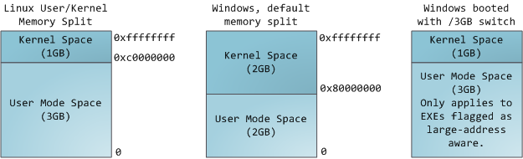
Memory
source: https://manybutfinite.com/post/anatomy-of-a-program-in-memory/

Slide 40
Memory
source: https://manybutfinite.com/post/anatomy-of-a-program-in-memory/

Slide 41
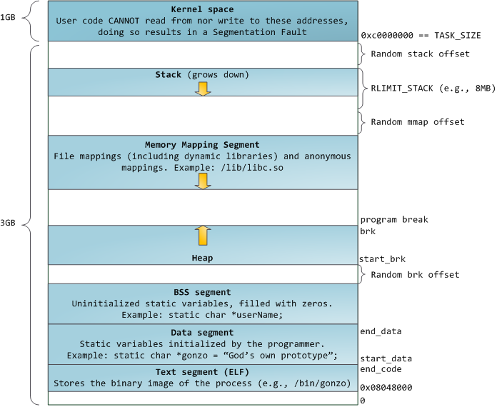
Memory
source: https://manybutfinite.com/post/anatomy-of-a-program-in-memory/

Slide 42
Memory
source: https://manybutfinite.com/post/anatomy-of-a-program-in-memory/

Slide 43
Memory
source: https://manybutfinite.com/post/anatomy-of-a-program-in-memory/

Slide 44
Memory
source: https://manybutfinite.com/post/anatomy-of-a-program-in-memory/

Slide 45
Memory
source: https://manybutfinite.com/post/anatomy-of-a-program-in-memory/

Slide 46
Memory
source: https://manybutfinite.com/post/anatomy-of-a-program-in-memory/

Slide 47
Memory
source: https://manybutfinite.com/post/anatomy-of-a-program-in-memory/

Slide 48
Memory
source: https://manybutfinite.com/post/anatomy-of-a-program-in-memory/

Slide 49
Memory
int = 0;
source: https://manybutfinite.com/post/anatomy-of-a-program-in-memory/

Slide 50
Memory
int = 0;
source: https://manybutfinite.com/post/anatomy-of-a-program-in-memory/

Slide 51
Memory
ptr = new Object();
source: https://manybutfinite.com/post/anatomy-of-a-program-in-memory/

Slide 52
Memory
ptr = new Object();
source: https://manybutfinite.com/post/anatomy-of-a-program-in-memory/

Slide 53
Memory
static int;
source: https://manybutfinite.com/post/anatomy-of-a-program-in-memory/

Slide 54
Memory
static int;
source: https://manybutfinite.com/post/anatomy-of-a-program-in-memory/

Slide 55
Memory
static int = 0;
source: https://manybutfinite.com/post/anatomy-of-a-program-in-memory/

Slide 56
Memory
static int = 0;
source: https://manybutfinite.com/post/anatomy-of-a-program-in-memory/

Slide 57
Memory
... = “Hello world”;
source: https://manybutfinite.com/post/anatomy-of-a-program-in-memory/

Slide 58
Memory
... = “Hello world”;
source: https://manybutfinite.com/post/anatomy-of-a-program-in-memory/

Slide 59
Homework
Now that you have the master key, you can decrypt the traffic in the pcap file and analyse it for interesting secrets.
3. Hack the poor guys facebook account and leave a message (from himself) on his wall.

